Slide 1
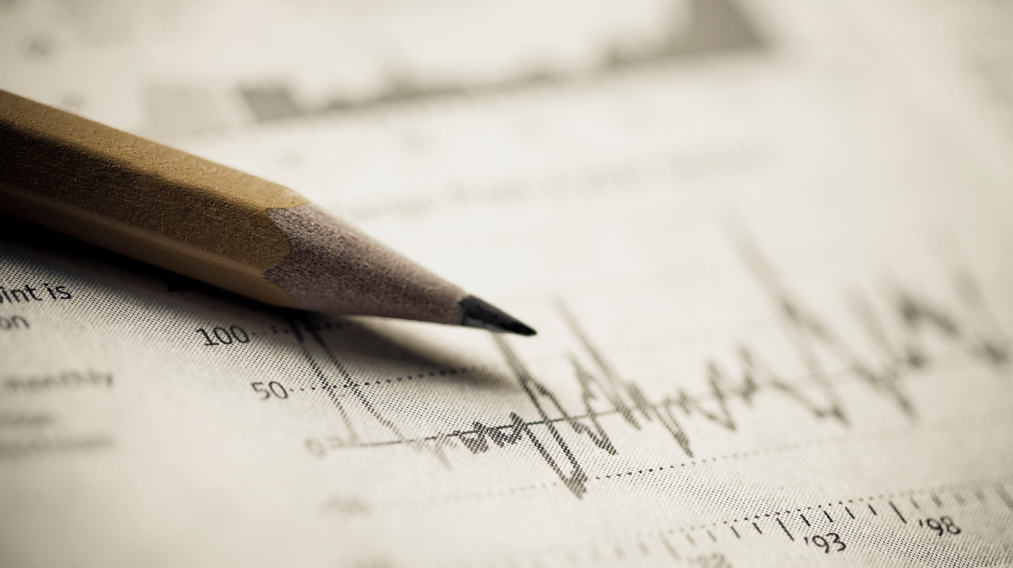
PROBABILITY
&
STATISTICS

Slide 2
Chance is a possibility of something happening.
Examples:
Is it possible that we observe a black color sun? Answer: It is not possible to observe a black color sun. The chance of this happening is zero.
Is it possible that if today is a Monday, tomorrow is a Tuesday? Answer: Definitely, it is possible. There is a 100 % chance that tomorrow is a Tuesday if it is a Monday today.
Is it possible that we have a pizza for dinner? Answer: It may or may not be possible, there is some chance. We may not be absolutely sure about having a pizza for dinner.
Observation:
Example 1 and example 2 had a clear possibility of occurrence. However, example 3 had an unclear possibility of occurrence.

Slide 3
When a chance takes us to a situation where the outcome cannot be predicted exactly (i.e. there is an unclear possibility of occurrence), Probability is used to quantify the variability in the outcome.
What is Probability?
By Probability, we measure the likelihood of an event in which we are interested.
What is the Likelihood of an event?
The Likelihood of an event is the frequency with which the event may occur.

Slide 4
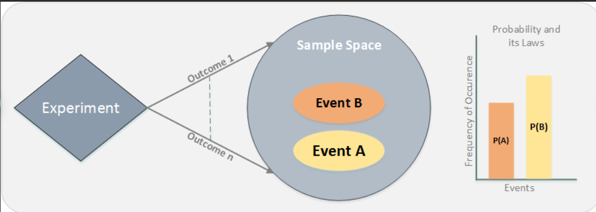

Slide 5
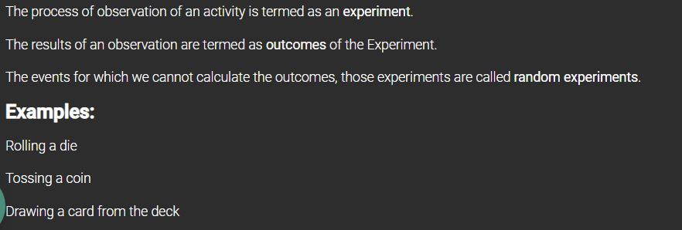

Slide 6
Sample Space is the set of all the possible outcomes of a random experiment. It can be of two types which are as follows:
Continuous sample space
Example: Value of stock for a company can be between $15 and $25 = {15.01, 15.02, …,24.98, 24.99, 25}
Discrete sample space
Example: Number of people attending the meeting can be between 10 and 20 = {10, 11, 12,…,20}

Slide 7
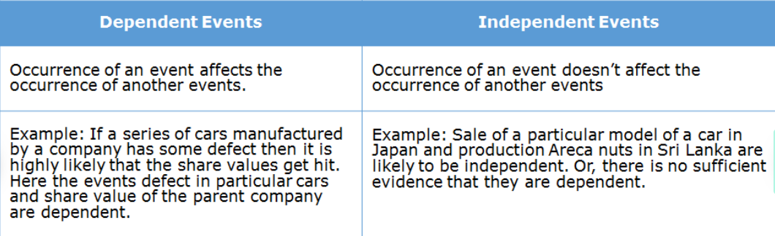

Slide 8
SET

Slide 9
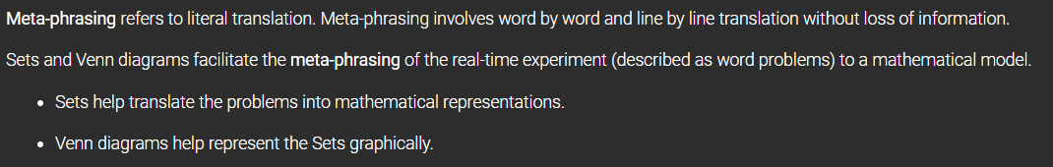

Slide 10
A Set is a collection of distinct objects/elements. It is a collection of all possible outcomes.
The Sets help translate the problems to mathematical representations using set notations.
If a set contains finite no. of elements (x₁,x₂,x₃) it can be represented as S={x₁,x₂,x₃}
Example: Set of all possible outcomes of a die roll S={1,2,3,4,5,6 }
If a set contains infinite no. of elements (x₁,x₂,x₃,…..) it can be represented as S={x₁,x₂,x₃,…..}
Example: Set of all possible positive real numbers S={0,0.01,1,1.5,2,……}

Slide 11

Intersection: The intersection of two sets A and B is represented as A ∩ B
Union: The union of two sets A and B is represented as A ∪ B
Complement: The complement of Set A is represented as
Difference: The difference of Set A and B is represented as A — B

Slide 12
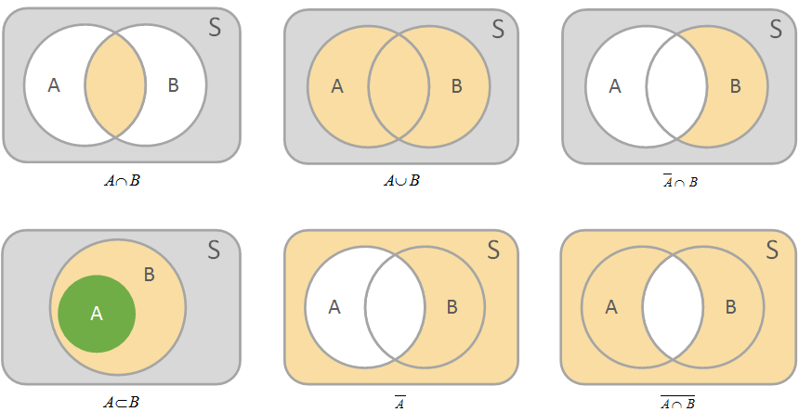

Slide 13
Counting Techniques

Slide 14
Let's understand something in the context of a random experiment. For random experiments, it might be required for us to count the possible number of outcomes.
Now in order to count the possible number of outcomes, the simplest way to do that is to list all the possible outcomes of the given experiment.
However, for certain applied problems if the outcomes are too many in number it is not possible to list out all the possible outcomes.
For applied problems where the count of possible outcomes is essential and listing out all possible outcomes is not feasible we adopt sophisticated counting techniques.
Some of these commonly used techniques are:
Product Rule
Sum Rule
Combinations
Permutations

Slide 15
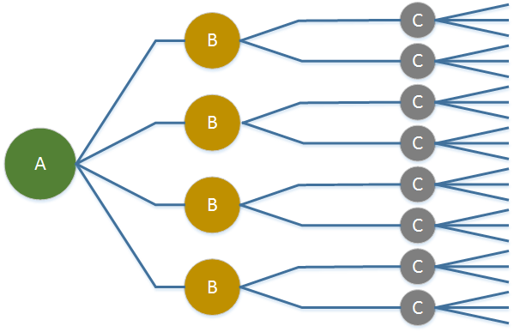
Product Rule
Consider a 3 stage experiment where stage A has 4 choices, stage B has 2 choices and stage C has 3 choices.
Let us try to find out the number of ways in which we can complete the experiment.
Total ways to complete the experiment = 4×2×3 i.e. (#Choices in stage A) × (#Choices in stage B) × (#Choices in Stage C)

Slide 16
Sum Rule
Scenario: Consider stocks in the banking and automotive sectors.
Stocks(Bank) = {Bank1, Bank2, Bank3}
Stocks(Auto) = {Auto1, Auto2, Auto3, Auto4}
If an investor likes to invest in either banking OR automotive stocks then how many total possible ways can he invest?
Total possibilities to invest in either banking OR automotive stock is 3 + 4 =7
The investor has to make a single choice from all the stocks added together,
i.e. (Total number of Banking stocks + Total number of Automotive stocks)

Slide 17
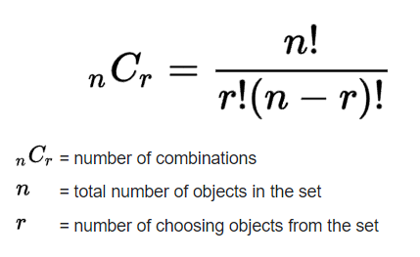

Combinations
Scenario: Consider stocks of the automotive sector.
Stocks(Auto) = {Auto1, Auto2, Auto3, Auto4} If an Investor wants to invest in 2 automotive stocks, in how many possible ways can he invest?
Total possible ways to invest are:
n - Total number of automotive stocks.
r - Number of stocks the investor wants to invest in.

Slide 18
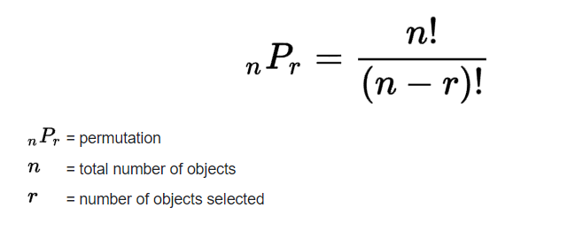

Permutations
Permutation deals with Order/Sequence.
Scenario: Consider stocks of the banking sector.
Stock(Bank) = {Bank1, Bank2, Bank3}
If an investor wants to invest in 2 banking stocks out of the available 3 banking stocks, how many ways can he invest if ordered one at a time?
Total possible ways to make this investment is =
n- Total number of stocks.
r – Number of stocks to be invested.

Slide 19
Axioms
For a Finite Sample Space S, Consider an Event A.
The probability P(A) which is a real number assigned to the Event A must follow the below axioms :
P(A) >= 0
P(S) = 1
If event A and Event B are mutually exclusive then, P (A U B) = P(A) + P(B) , (A ∩ B ) = ∅

Slide 20
Elementary Properties
Using the axioms the following properties of probability can be obtained:
P ( A ) = 1 - P (A)
P (∅) = 0
P(A) < P(B) if A ⊂ B
P(A) <= 1
P(A U B) = P(A) + P(B) - P(A ∩ B)

Slide 21

Scenario: Let's try to understand computing probability by taking an example of a box having 3 red balls, 2 blue balls and 1 green ball. Let's take one ball randomly. What would be the probability that the selected ball will be a blue ball?
Solution:
Total possible outcomes = Total number of balls = 3+2+1=6
Total ways a blue ball can be drawn = ²C₁ = 2
The probability of drawing a blue ball =

Slide 22
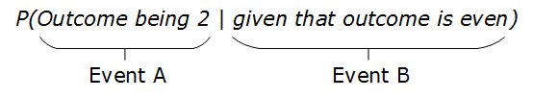
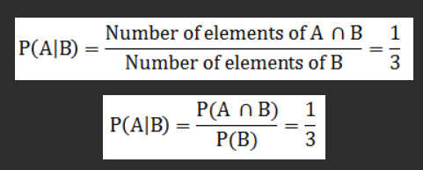
Conditional Probability is used to determine the likelihood of an event when a partial information about the event is known.
Scenario: In an experiment of rolling a die, what is the likelihood that the outcome is 2, given that the outcome is even?
Consider a fair roll of a die i.e. all the outcomes of an experiment have an equal probability of occurrence = 1/6.
It is given that the outcome is even (Event B)– so possible values are 2,4,6. Therefore the total number of elements for Event B =3
Event A can take any ONE value amongst 2,4,6. Therefore the total number of elements for Event A=1 So,

Slide 23
STATISTICS
The collection, analysis, interpretation, presentation and organization of data is termed as statistics.

Slide 24
The health and welfare council wants to survey your city to understand the lifestyle of the residents and if need be, improve the facilities provided based on the conclusions drawn from the data collected.
Some of the data being collected for this analysis is listed below:
Personal information such as name, age, income of household and educational qualifications.
Quality of water supply across the city.
Medical facilities such as availability of hospitals, doctors etc.

Slide 25
Statistics is used to study a population/process (data).
In the example cited earlier, the data is personal information of residents, water being supplied and information about the medical facilities.
We can leverage the analysis of this data to answer a few questions which could be but not limited to:
What is the average income of households in the city?
Which is the most common disease in a given area?
How much water does a household use in a month?
How good is the water being supplied?
Are there enough medical facilities being provided?

Slide 26
Population and Sample
When all data required for observation/analysis is collected and studied, the data is referred to as the population.
On the other hand, when limited data is being collected/analyzed, this data is referred to as sample and is used as an indicative of the entire population.
Example:
Population: Data is being collected from all the residents of the city about their age, educational qualification and medical history.
Sample: On the other hand to analyze the water supply, a few litres of water are being collected from different water supply lines that run in the city.

Slide 27
Statistics can be broadly classified into descriptive and inferential statistics.
Descriptive statistics
Summarization of data to describe the main features of the sample.
For example, in the survey cited earlier, the knowledge of descriptive statistics can be leveraged to answer some questions like:
What is the average income of households in the city?
Which is the most common disease in a given area?
Inferential statistics
When working with samples of the population the techniques and processes we use to draw conclusions come under inferential statistics let's understand it as we progress through this course.
For example, in the survey cited earlier, inferential statistics can be used to answer the following questions:
How good is the water being supplied?
Are there enough medical facilities being provided?

Slide 28
Descriptive statistics
Some of the measures that used to describe the data are:
The Measures of central tendency
The Measures of dispersion
The Measures of shape

Slide 29
The Arithmetic Mean (generally known as "average") is a broadly used measure to describe a population using a single value.
Arithmetic Mean is a measure which is used for numeric data and is a single value that represents the typical value in the given set of numbers. For example, mean marks of the class is 70 out of 100.
In the examples described earlier, arithmetic mean is used while answering the following questions:
How much water does a household in this city use in a month?
How many patients does a doctor in the city see in a day?
The weighted mean is used when some values in the data set contribute more than others.
The geometric mean is used while finding the average of numbers that represent growth rate.
The Harmonic mean is a better estimate of the average of data in situations where the data represents rates/ratios such as speed (km per hr.), heart rate(beats per min.), frequency etc.

Slide 30
The presence of extreme values (unusually large/small values) in data affects the mean/average.
Median is another measure of central tendency, is generally the preferred value in such cases. Why? We would understand.
Median is the value that lies at the center of the data set when data is ordered. Median divides the data into equal halves when the data is sorted.
Finding the median:
If there are an odd number of values, the median is the value at the Centre that divides the data into equal halves
If there are even number of values, the median is the average of the two middle values

Slide 31
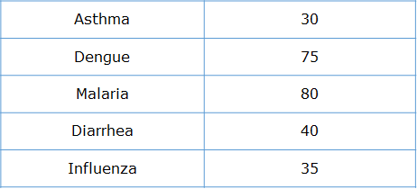
Data that is most frequently occurring in a data set is called Mode.
Based on the count of occurrences of diseases, one can say that Malaria is the mode of this data set. However, since there is no significant difference between the count of Malaria and that of Dengue, we can consider both of these diseases to be the modes of this data set,

Slide 32
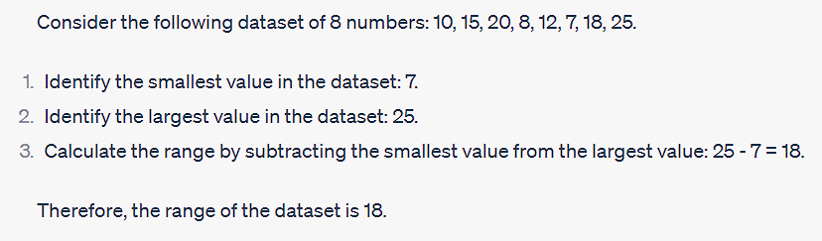
Measures of dispersion
The Range is the simplest measure of dispersion that aims at providing an idea of how much the data varies in the data set.
The Range is expressed as
range = maximum value in a data set - minimum value in a data set

Slide 33
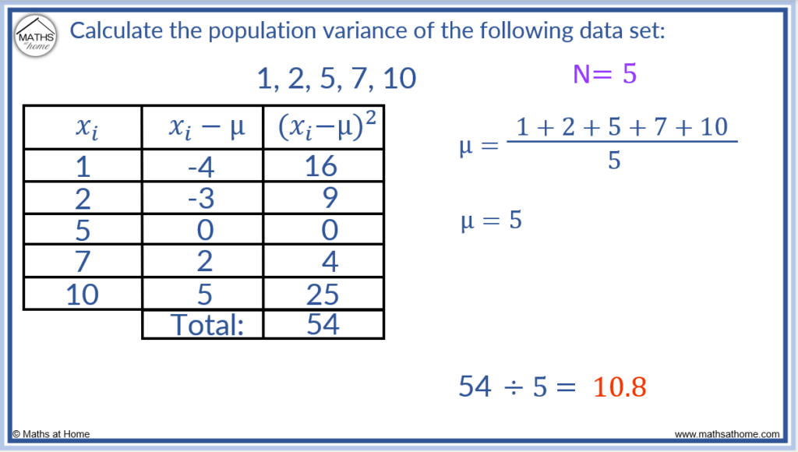
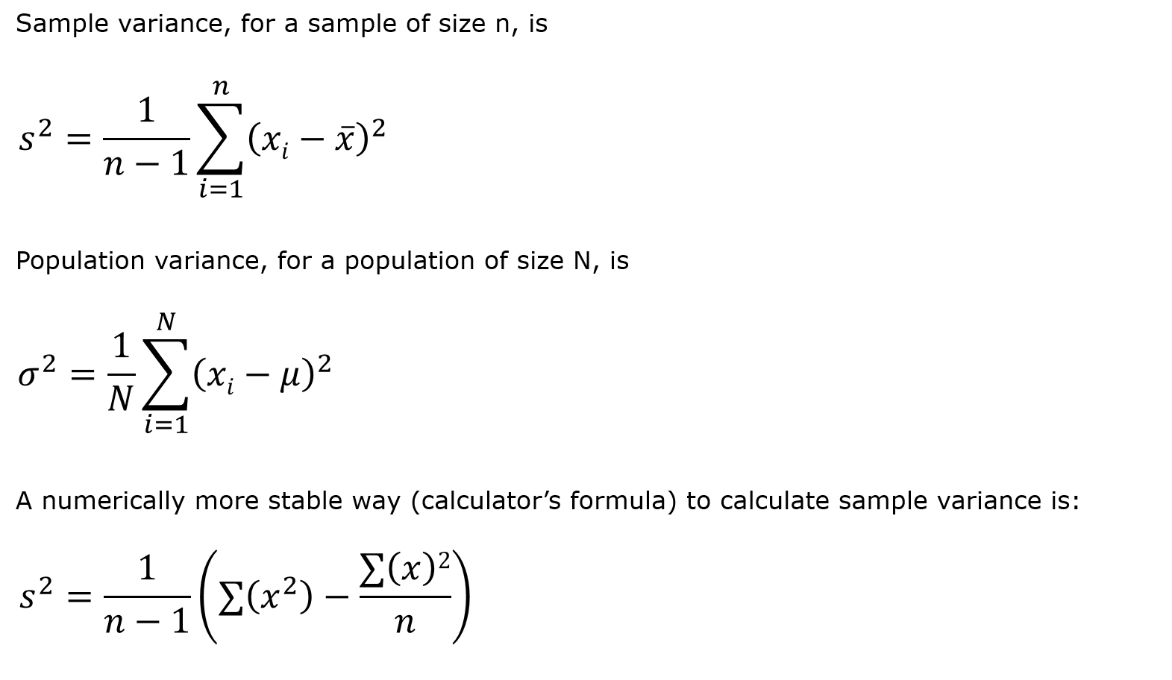
Variance is a better indicator of dispersion
it describes the deviation of data from each other and from the mean.
Variance for a population of size N can be calculated by using the following formula:

Slide 34
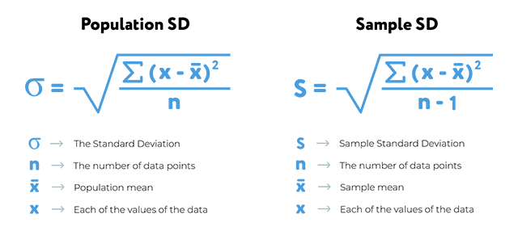
The actual variation of the data from the mean is represented by Standard Deviation

Slide 35
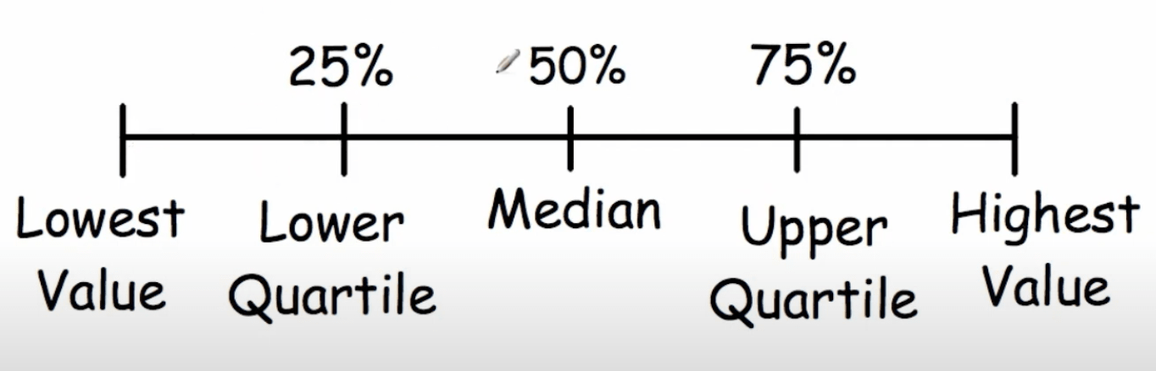
Quartiles are 3 points in the data set that divide the data set into 4 equal groups.
The first quartile (Q₁) is the 25th percentile of the data set i.e. the value below which 25% of the data lies.
The second quartile (Q₂) is the 50th percentile of the data set i.e. the value below which 50% of the data lies. This is the median (m) of the data set
The third quartile (Q₃) is the 75th percentile of the data set i.e. the value below which 75% of the data lies.

Slide 36
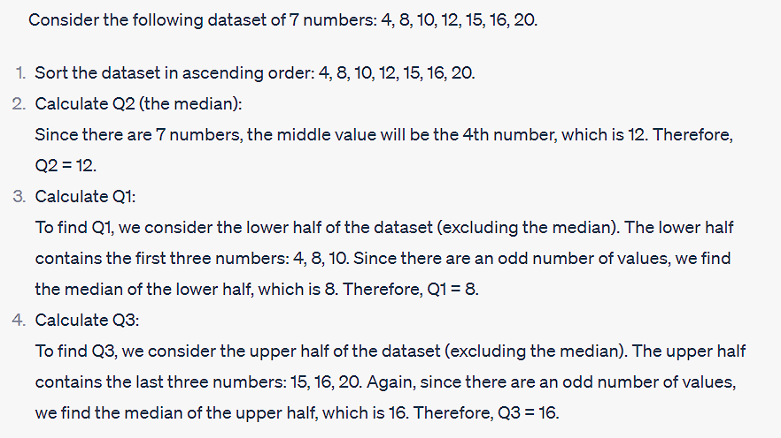
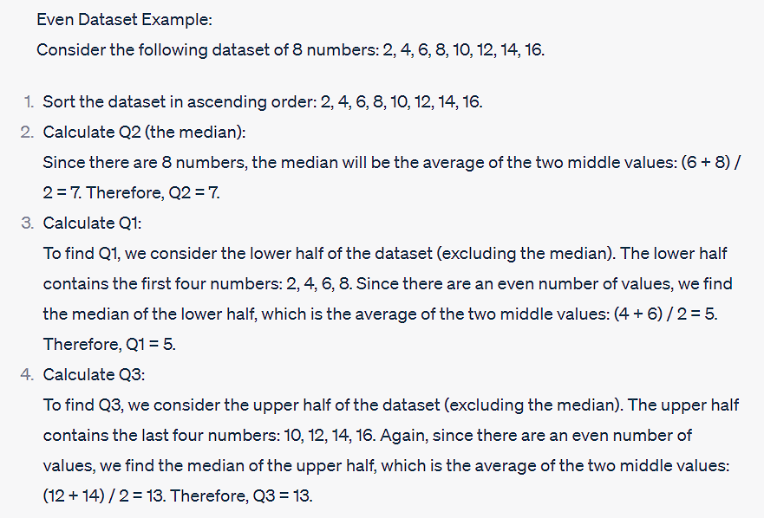

Slide 37
The interquartile range is the difference between the third quartile(Q₃) and the first quartile(Q₁). This range is used to indicate the spread of the data and is a better measure than range because min and max (used in range) are highly volatile in the presence of unusual values.
The interquartile range of the example cited earlier is
IQR = (Q₃-Q₁)

Slide 38
Measures of shape
From the survey that collected all personal information of residents such as name, age, monthly household income, the health officer wants to know the following details so as to provide additional aid in communities having low monthly household income.
In order to come to some conclusion we would need to answer some questions in order to make sure that the facilities are being provided in an optimal manner:
What is the average monthly household income of the community?
Is average the right measure to judge the community, is there a presence of unusual values in this data set.
If the facilities are going to be provided to households who lie below 20% of the average of the community, how many households will be covered?
To answer the questions posed by the health officer, we can choose to visually represent the data and derive this information at a glance.
To understand the distribution of data statistically we use the Measures of the Shape such as skewness and kurtosis to describe the data set better.

Slide 39
Skewness is the measure of lack of symmetry of the data in comparison with symmetric distribution. In symmetrically distributed data set, the mean and the median coincide.

Slide 40
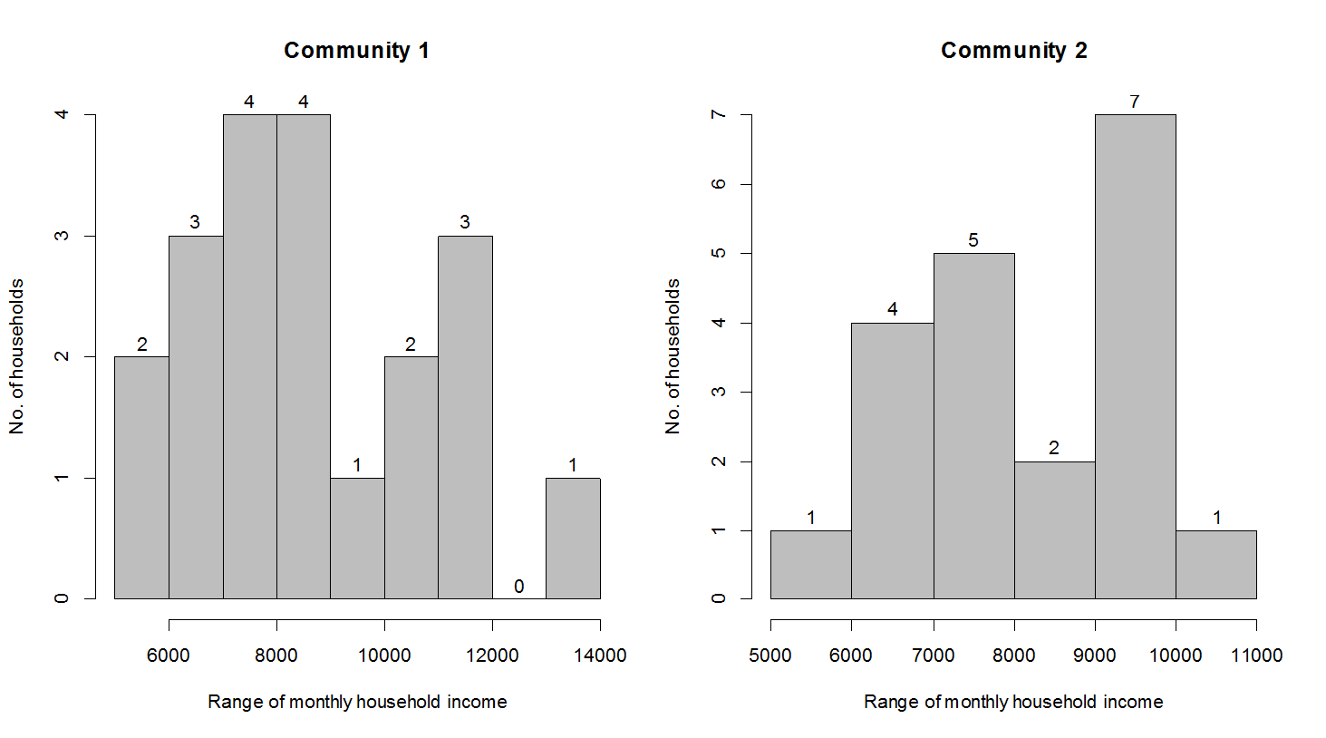
The data of two communities comprising 20 households is shown below:
For the given data,
Mean of community 1: 8683.4, and Median of community 1: 8357
Mean of community 2: 8225.6 and Median of community 2: 8213
The mean for this data is 8683.4 and the median is 8357.
Here it is evident that due to the presence of a few households having a monthly income which is greater than 11000, the mean is larger than the median.
What if there were a few more households which had much larger incomes? In that case, the mean would shift further away and grow larger than the median. What we observe here is termed skewness.

Slide 41
Kurtosis helps us identify whether the data spread around the mean is high or not.
A higher value of kurtosis indicates that data is largely centred around the meanwhile a lower value of kurtosis indicates that data is not centered around the mean.
A value of kurtosis above 3 indicates a peak, while that below 3 indicates flatness.

Slide 42
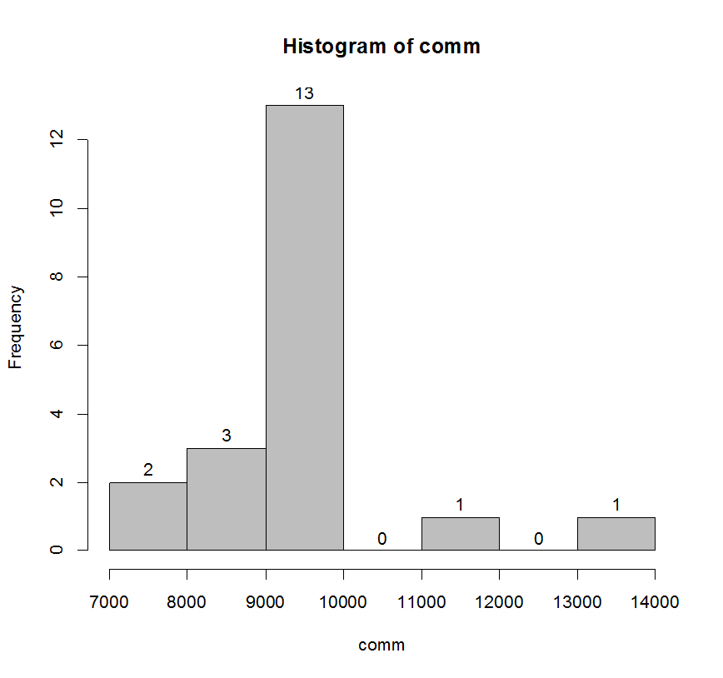
A community of day workers is working at the same company for almost similar salaries, the data this community is observed as part of the survey. Let's have a look at the histogram for the data of this community.
The Observed mean for this data set is 9207.9. Also, We observe that the concentration of data around the mean is high.
The nature of data to peak or flatten about the mean can be described using kurtosis.

